Slide 1

JavaScript, Sixth Edition
Chapter 12
Introduction to jQuery

Slide 2
Objectives
When you complete this chapter, you will be able to:
Select elements using jQuery syntax
Use built-in jQuery functions
JavaScript, Sixth Edition

Slide 3
Introduction to jQuery
jQuery
  Commonly used library
  Enables developers to implement common JavaScript tasks with minimal code
JavaScript, Sixth Edition

Slide 4
Implementing jQuery
Cross-browser library
  jQuery 1.x supports IE 6, 7, and 8
  jQuery 2.x supports only IE 9 and later
    Requires less extra code, so smaller file
JavaScript, Sixth Edition

Slide 5
Including the Library
Link .js file containing library to HTML document
  Can download from jquery.com
  Can specify public location on CDN
JavaScript, Sixth Edition

Slide 6
Starting a jQuery Statement with $
All jQuery code conforms to JavaScript rules
  Uses shortcuts that can look like different language
Every jQuery statement begins with $
  Specifies that any code that follows should be interpreted using jQuery library
JavaScript, Sixth Edition

Slide 7
Selecting Elements with jQuery
$ followed by reference to elements on which statement operates
  Reference contained in parentheses
Use CSS selector in quotes to select elements
Example–to operate on h1 elements:
  ^{$("h1")}
Example—to select elements in odd class:
  ^{$(".odd")}
Concise version of querySelectorAll() method:
  document.querySelectorAll(".odd")
JavaScript, Sixth Edition

Slide 8
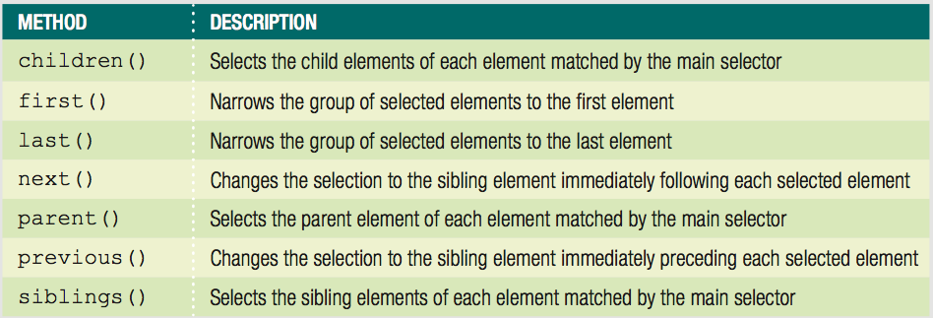
Traversing the DOM with jQuery Methods
Can select other elements in relation to selection
  Use jQuery DOM traversal methods
Table 12-1 jQuery methods for DOM traversal
JavaScript, Sixth Edition

Slide 9
Traversing the DOM with jQuery Methods (cont'd.)
Select children of original selection:
  ^{$("ul.mainmenu li").children()}
Narrow selected items with selector in method's parentheses:
  $("ul.mainmenu li").children("ul")
JavaScript, Sixth Edition

Slide 10
Manipulating the DOM with jQuery Methods
Plain JavaScript
  JavaScript without jQuery
jQuery API includes methods for performing actions on selected elements
JavaScript, Sixth Edition

Slide 11
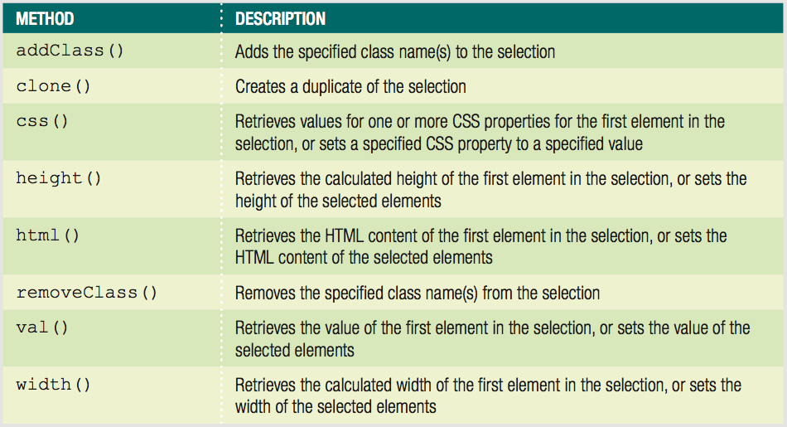
Manipulating the DOM with jQuery Methods (cont'd.)
Table 12-2 jQuery methods for manipulation
JavaScript, Sixth Edition

Slide 12
Manipulating the DOM with jQuery Methods (cont'd.)
Many jQuery methods serve dual function
  Look up a value
  Set that value
^{1 $(".odd").width();}
2 /* returns the computed width value for the first
3 element with the class name "odd" */
^{4 $(".odd").width("5em");}
5 /* sets the width of all elements with the class name 6 "odd" to 5em */
JavaScript, Sixth Edition

Slide 13
Specifying an Event Handler
Can group jQuery statements into functions
  Standard JavaScript syntax
^{function display() {}
$("ul.mainmenu li").children("ul").addClass("show");
}
JavaScript, Sixth Edition

Slide 14
Specifying an Event Handler (cont'd.)
Backward-compatible event listener easier in jQuery
  Start with $
  Specify selector for element(s) associated with event
  Finish with method that specifies event and action(s)
JavaScript, Sixth Edition

Slide 15
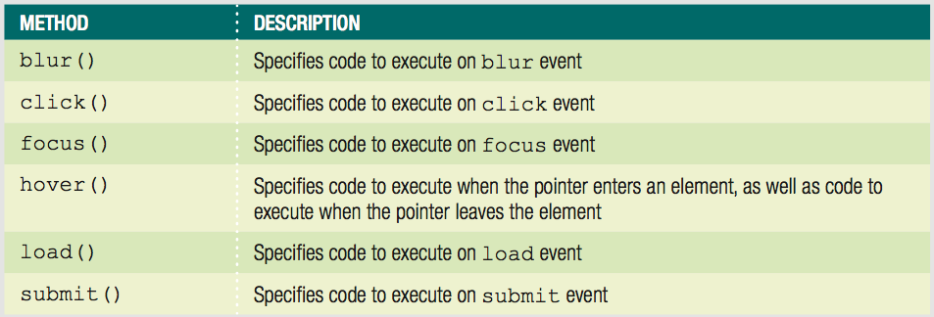
Specifying an Event Handler (cont'd.)
Performs as described with function in ()
Empty () instead fires indicated event
Table 12-3 jQuery methods for common events
JavaScript, Sixth Edition

Slide 16
Specifying an Event Handler (cont'd.)
1 $("form.order").submit(validateForm);
2 /* specifies validateForm() as event handler when form 3 is submitted */
^{4 $("form.order").submit();}
5 /* fires submit event on form */
JavaScript, Sixth Edition

Slide 17
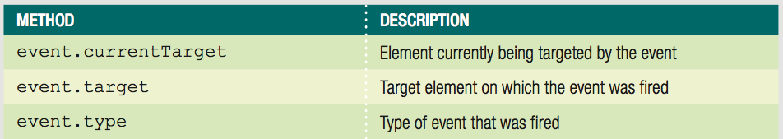
Specifying an Event Handler (cont'd.)
Table 12-4 jQuery event properties
JavaScript, Sixth Edition

Slide 18
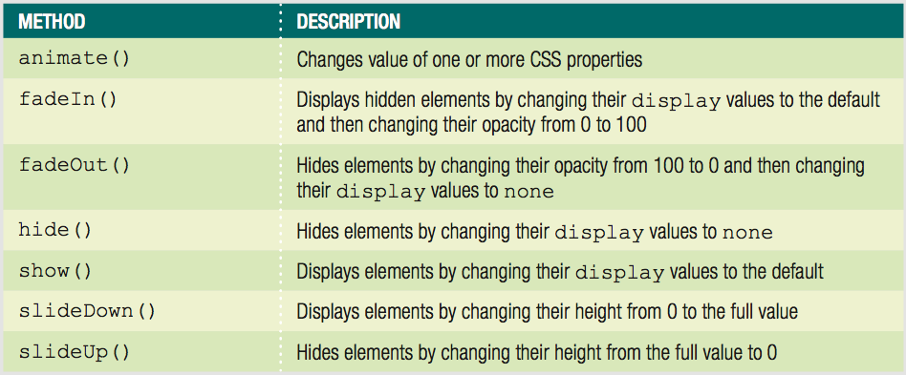
Using jQuery Built-in Effects
jQuery includes visual animation methods
Table 12-4 jQuery animation methods
JavaScript, Sixth Edition

Slide 19
Using jQuery Built-in Effects (cont'd.)
All methods take value in milliseconds as argument
  Animation occurs in specified time frame
Some also support slow and fast keywords
JavaScript, Sixth Edition

Slide 20
Summary
jQuery enables developers to implement common tasks with minimal code
Must link .js file containing library to HTML document
Every jQuery statement starts with $
Select elements in jQuery with CSS selector in quotes
Can modify a selection
  Append DOM traversal method to selection code
JavaScript, Sixth Edition

Slide 21
Summary (cont'd.)
jQuery API includes methods for performing actions on elements
Many methods allow you to look up or set value
Event listener consists of
  $
  selector
  method
jQuery includes visual animation methods
JavaScript, Sixth Edition

